Slide 1
Observer Pattern

Slide 2
e-Commerce Application
New requirement: Take actions for new customers
  Send a welcome e-mail to the customer.
  Verify the customer's address with the post office.

Slide 3
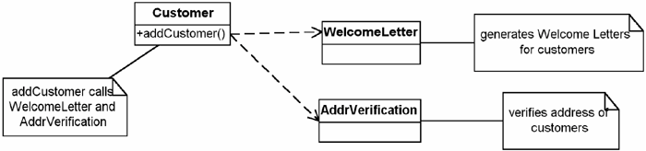
If we knew in advance ..
Hard Code the behaviour
The problem? Requirements always change
Class | Responsibility
Customer | When a customer is added, this object will make calls to the other objects to have the corresponding actions take place.
WelcomeLetter | Creates welcome letters for customers that let them know they were added to the system.
AddrVerification | This object will verify the address of any customer that asks it to.

Slide 4
The Observer Pattern
Intent
  the intent of the Observer pattern is to "define a one-to-many dependency between objects so that when one object changes state, all its dependents are notified and updated automatically. [GOF]
Simply stated:
  handling notification automatically

Slide 5
A Common Pattern
It also goes by the names Dependents and Publish-Subscribe
Where you can find them
  the notify process in COM
  It is implemented in Java with the Observer interface and the Observable class
  In rule-based, expert systems, they are often implemented with daemon rules.

Slide 6
Applying Observable Pattern
Two things are varying
  Different kinds of objects There is a list of objects that need to be notified of a change in state. These objects tend to belong to different classes.
  Different interfaces Because they belong to different classes, they tend to have different interfaces.

Slide 7
1 Make the Observers behave in the same way
  All observers have the same interface
  In C# and Java, implement this with an interface
  In C++, use inheritance

Slide 8
2. Have the observers register themselves
Define two methods in the Subject
  attach(Observer) adds the given observer to its list of observers
  detach(Observer) removes the given observer from its list of observers

Slide 9
3 Notify the observers when the event occurs
  each Observer implements a method called update.
  Subject implements a notify method that goes through its list of Observers and calls this update method for each of them
  The update method should contain the code to handle the event.

Slide 10
4 Get the information from the subject
  You must also add method(s) to the Subject that allow the Observers to get whatever information they need

Slide 11
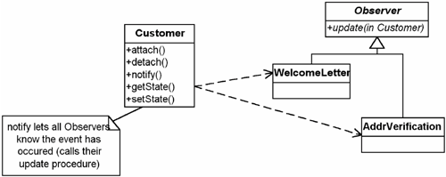
Back to e-Commerce Example

Slide 12
How things work
The Observers attach themselves to the Customer class when they are instantiated.
When a new Customer is added, the notify method calls these Observers.
Each Observer calls getState for information on the newly added Customer to see what it needs to do. Note: Typically, there would be several methods to get the needed information.

Slide 13
Customer Class
public class Customer {
static private Vector myObs;
static {
myObs= new Vector(); }
public static void attach(MyObserver o){
myObs.addElement(o);
}
public static void detach(MyObserver o){
myObs.remove(o);
}
public String getState () {
/* have other methods that will give the required information Here, just return null so this will compile*/
return null; }
public void notifyObs () {
/*set arg to something that helps tell the Observers what happened */
for (Enumeration e = myObs.elements(); e.hasMoreElements() ;) {
((MyObserver) e).update(this); } } }

Slide 14
interface MyObserver {
void update (Customer myCust);
}
class AddrVerification implements MyObserver {
public AddrVerification () { }
public void update ( Customer myCust) {
/* do Address verification stuff here can get more information about customer in question by using myCust*/
}
} //end of class AddrVerification

Slide 15
class WelcomeLetter implements MyObserver {
public WelcomeLetter () { }
public void update (Customer myCust) {
/*do Welcome Letter stuff // here can get more information about customer // in question by using myCust */
}
} //end of class WelcomeLetter

Slide 16
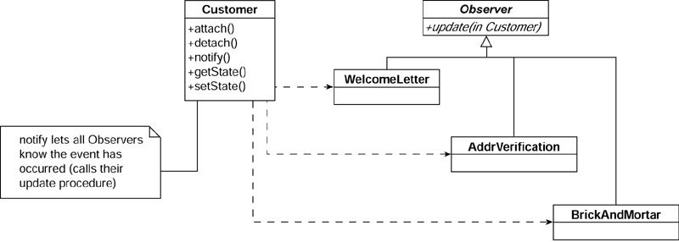
Add new functionality …

Slide 17
Key Features
Intent | Define a one-to-many dependency between objects so that when one object changes state, all its dependents are notified and updated automatically.
Problem | You need to notify a varying list of objects that an event has occurred.
Solution | Observers delegate the responsibility for monitoring for an event to a central object: the Subject.

Slide 18
Participants and collaborators | The Subject knows its Observers because the Observers register with it. The Subject must notify the Observers when the event in question occurs. The Observers are responsible both for registering with the Subject and for getting the information from the Subject when notified.
Consequences | Subjects may tell Observers about events they do not need to know if some Observers are interested in only a subset of events. Extra communication may be required if Subjects notify Observers which then go back and request additional information.
Implementation | Have objects (Observers) that want to know when an event happens attach themselves to another object (Subject) that is watching for the event to occur or that triggers the event itself. When the event occurs, the Subject tells the Observers that it has occurred. The Adapter pattern is sometimes needed to be able to implement the Observer interface for all of the Observer-type objects.

Slide 19
